Slide 1
17/03: Intro + Global Alignment
23/03: TBD: Trie & Trie Matching
20/04: TBD: BWT or De Brujin related algorithms
27/04: Bioinformatic pipeline management: snakemake / bash primer if required
28/04: Differential expression tool+example: DESeq2
11/05: Last laboratory on RNAseq pipeline+snakemake
Rosalind problems, e-mail submission
7 total points that will be added to your written exam mark, you have to submit them all at least 1 week before the written exam.
For Rosalind and simple 'glue' tasks for the last laboratory I do not enforce any specific language - do not use logical, functional or exoteric languages because I won't be able to evaluate them. Imperative/OOP languages are fine (R/Python/Rust/perl/C/Java[!]/C#/js - if you opt for something different check it with me :)).
I will notify you if some clarifications on your lab code are needed after the written test (forewarned is forearmed).

Slide 2
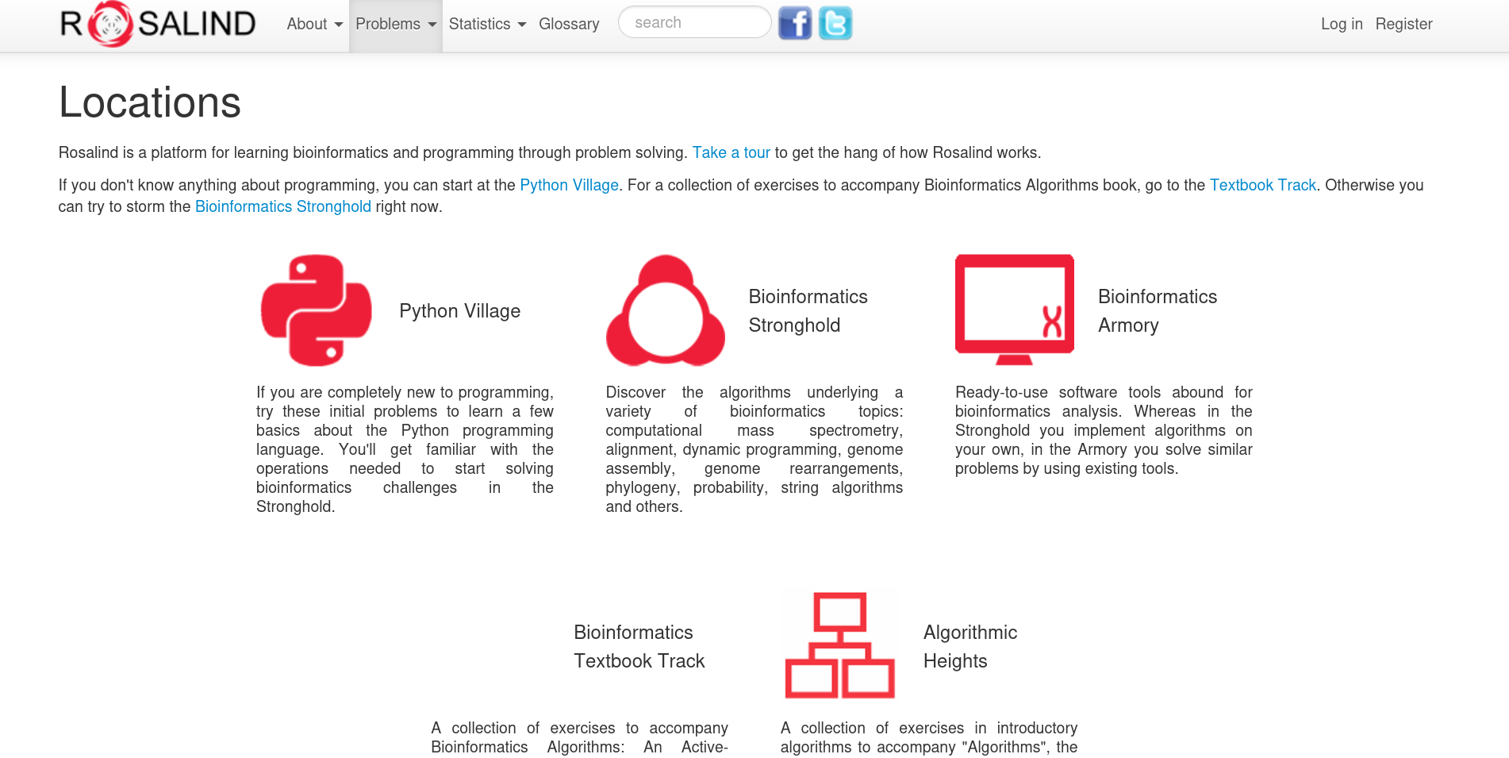

https://rosalind.info/classes/enroll/264ebfb9d6/

Slide 3
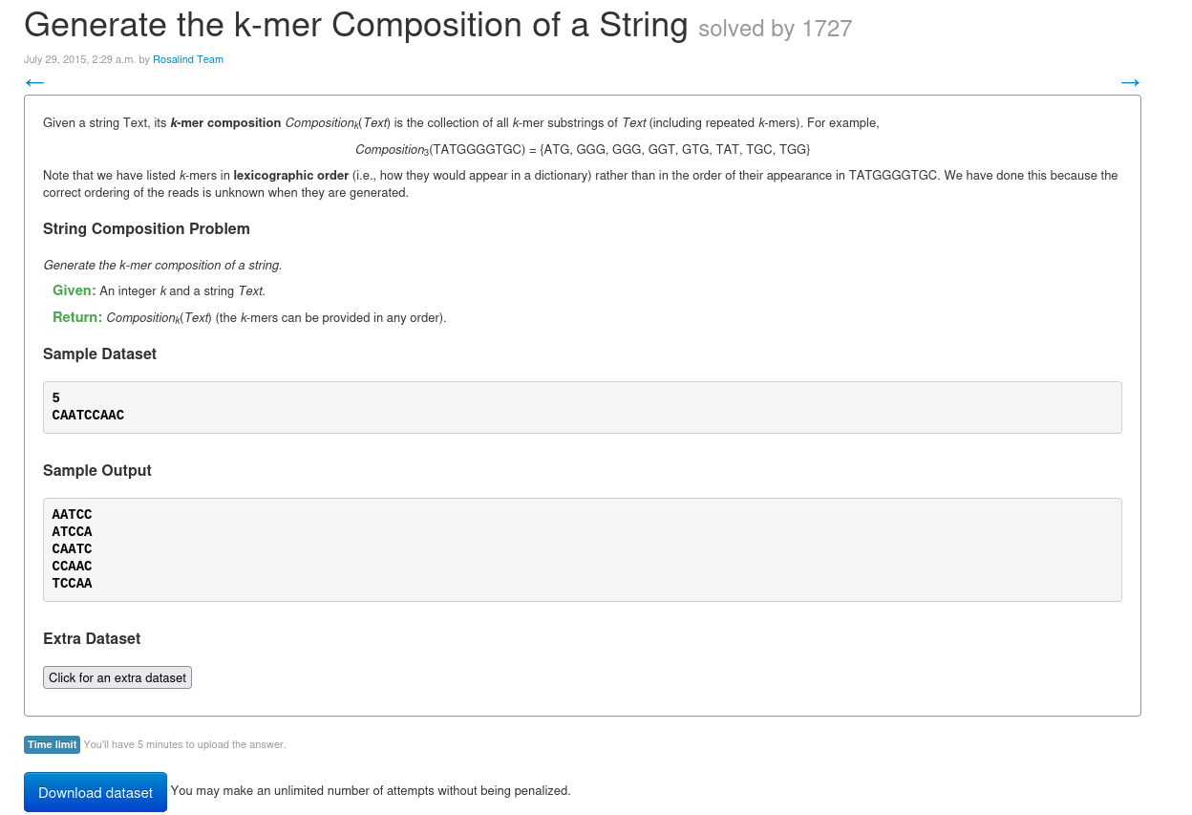
Do save your
code somewhere
safe other than
Rosalind
servers!
Notes:
log in with gmail account (vodka not vodkatad which is ircc account)

Slide 4
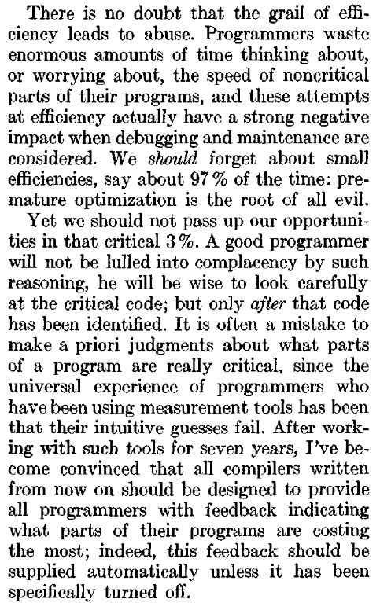
Premature optimization is the root of
all evil
Split the task in smaller steps, implement and test them separately
Use prints/debuggers to follow the algorithms step by step to help you while studying
Do not think too much about efficiency, focus on clear and well organized code where relevant steps are well commented (no excessive obvious comments please)
During labs you can ask if you are stuck on previous problems (or troubleshoot via email/webex/in my office), interacting with your colleagues is encouraged (identical solutions down to single bits can happen, but…)
Notes:
Knuth is the author of the multi-volume work The Art of Computer Programming. composizione tipografica markdown

Slide 5
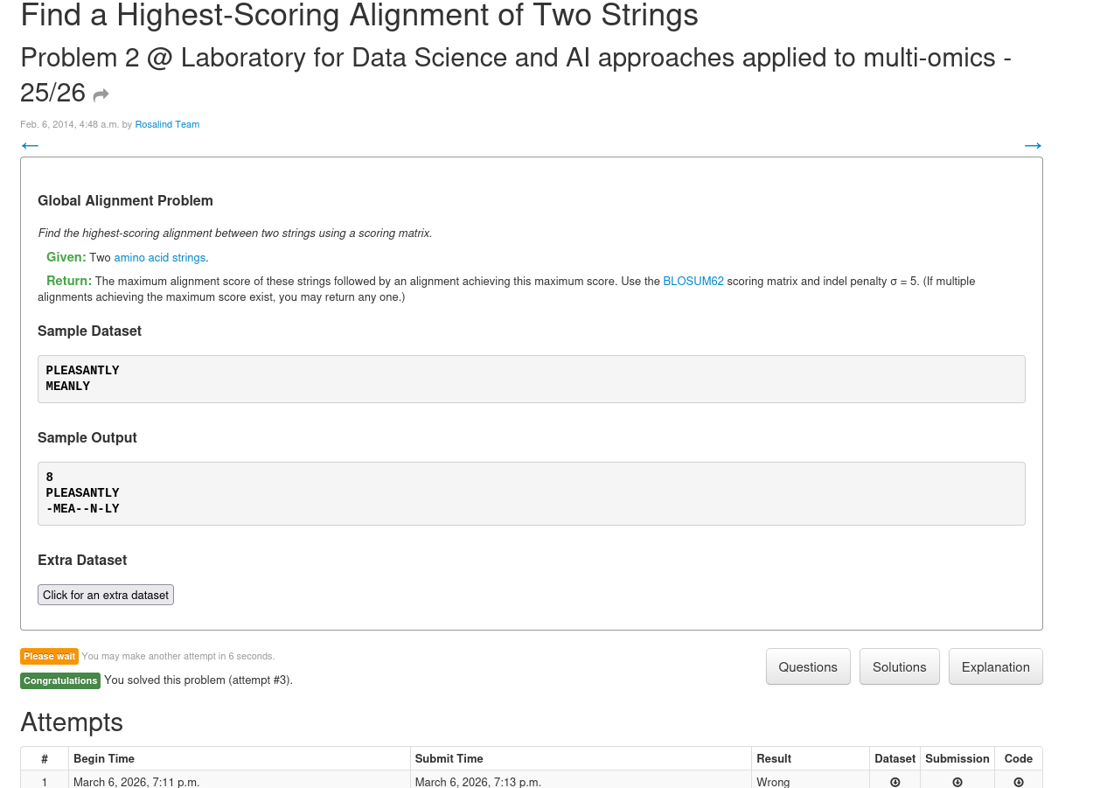
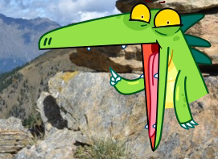
(I switched the order of the
two strings and
did not notice…)
Notes:
topological ordering is not an issue. backtracking ricorsivo anche no. p285 su PAM stopped at 266. Split in subproblems & Data structures

Slide 6
My suggestions for implementing the global alignment
Follow wikipedia page and think about matrices rather than DAG:
https://en.wikipedia.org/wiki/Needleman%E2%80%93Wunsch_algorithm
Split in two large functions: calculate scores & annotate direction, then traceback & print alignment
Start with simple scoring on DNA: match 1, mismatch&gap -1
Test your functions on small examples (CAT vs CAT)
Larger examples if everything goes well
Decide the priority between directions in case of ties in any way you want but try to test your decision - example
Then add the required aminoacid scoring matrix

Slide 7
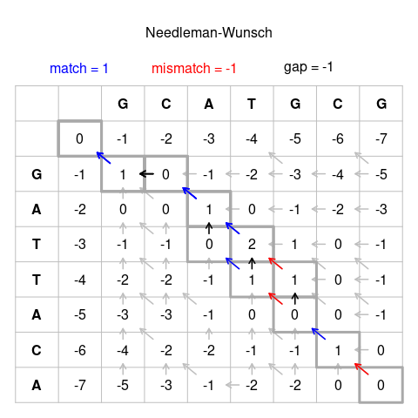
GCATG-CG
G-ATTACA
or
GCA-TGCG
G-ATTACA
?
Notes:
gap su stringa delle colonne freccia su

Slide 8
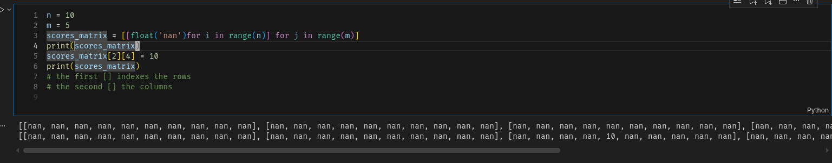
My implementation choices
Two 2D matrices: scores and traceback direction (encoded simply as 0, -1, 1)
Traceback starts from the bottom-right cell, the reconstructed alignment strings needs to be reversed

Slide 9
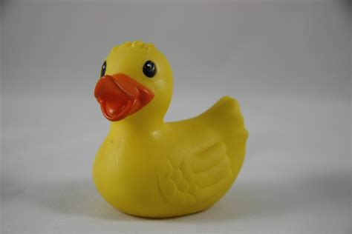
Debugging duck

